Slide 1

Amazon Web Service
Group 6
Togtokhbayar Gendensuren
Mayssa Elloumi
Van Duy Nguyen

Slide 2
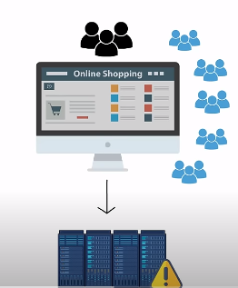


?

Slide 3

yes

Slide 4

Scalability
Cost Efficiency
Accessibility
Availability
Security
Maintenance
Integration
Traditional vs Cloud

Slide 5
Drawbacks when using cloud
Drawbacks | Cloud Platform
Dependency on Internet | Downtime or connectivity issues can disrupt access to applications and services.
Data Security | Storing sensitive data off-site can raise concerns about data breaches or unauthorized access
Vendor Lock-In | Dependency on a single provider.

Slide 6

Why should we choose AWS over other cloud services ?
1- extensive service offerings
2- market leadership
3- Robust partner ecosystem
4- Advanced security features
Notes:
1- EXTENSIVE SERVICE OFFERINGS​ - AWS provides a broader range of services compared to most other cloud providers, catering to diverse business needs.​
2- market leadership As a pioneer in cloud computing, AWS has a proven track record and continues to innovate, often setting industry standards.
3- Robust partner ecosystem - AWS has a vast network of partners, offering additional tools, services, and support to enhance the platform's capabilities.
4- Advanced security features - AWS offers comprehensive security measures, including encryption, access management, and compliance certifications.

Slide 7
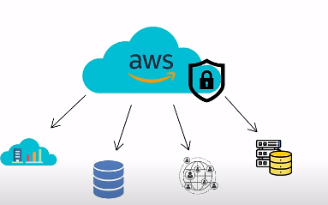

What is AWS?
Secure cloud computing platform ​
Pay-as-you-go model

Slide 8
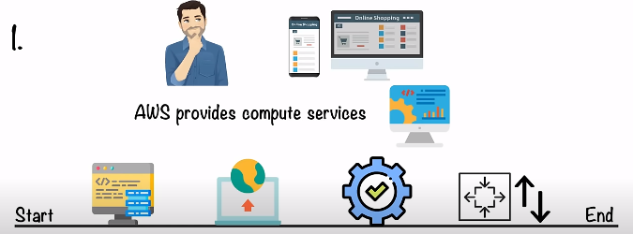
The aws services support the app development process from start to finish

Slide 9
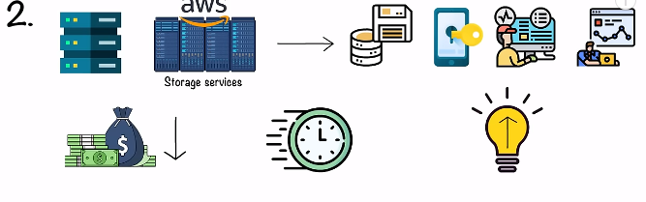
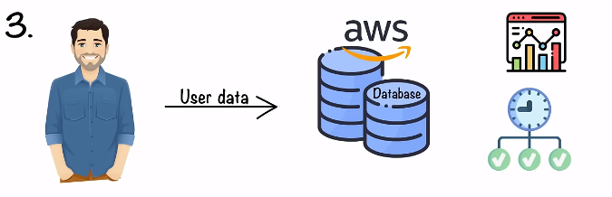
Popular service:
amazone s3
Ebs
s3 glacier
elastik file storage
Popular service:
amazone RDS
DynamoDB
Redshift

Slide 10
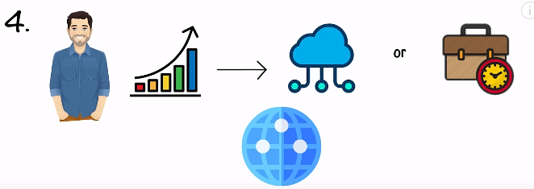

Popular services:
Amazone vpc
Amazone route 53
Elastic load balancing
Some other domains that AWS provides services in , are :
analytics
blockchain
containers

Slide 11
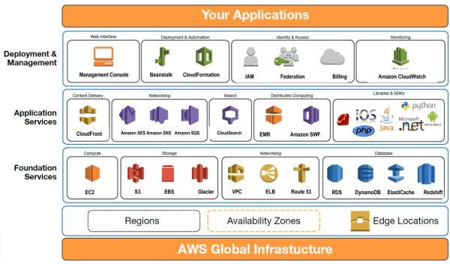

Slide 12
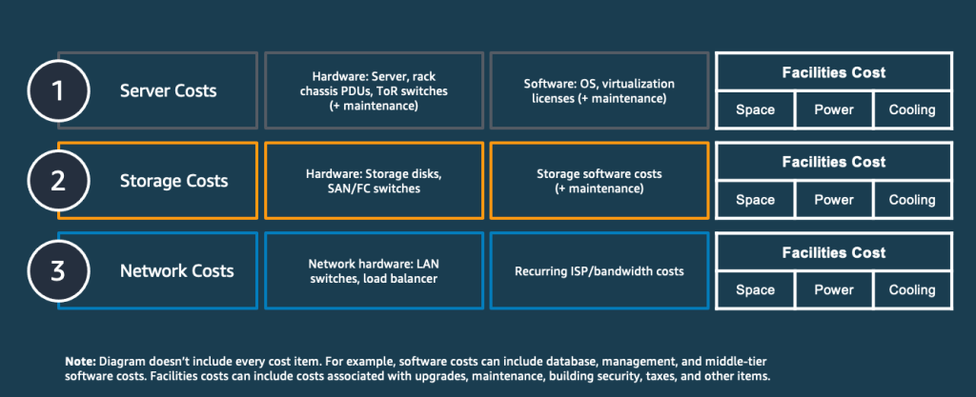
On-Premise Cost

Slide 13
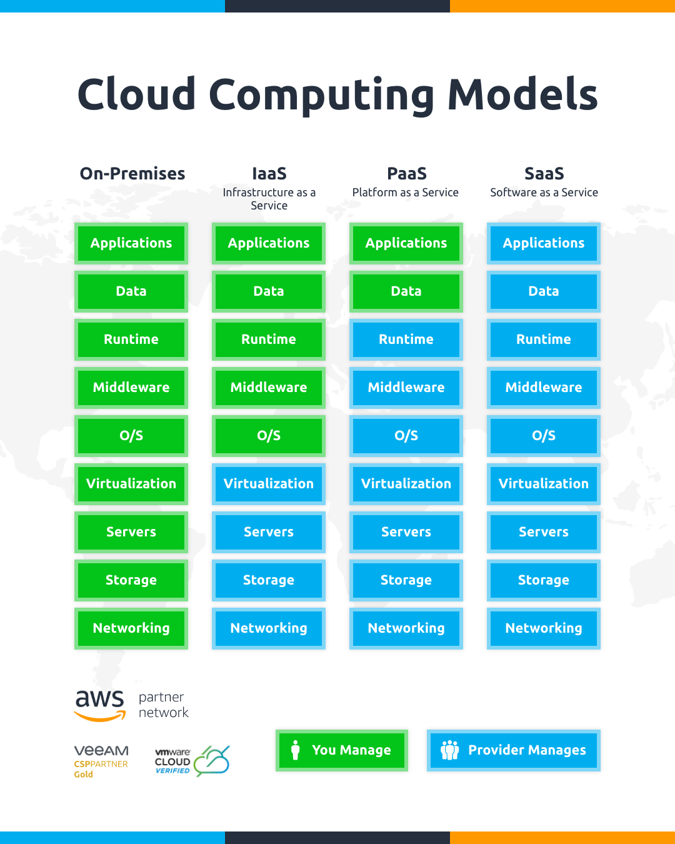

Slide 14
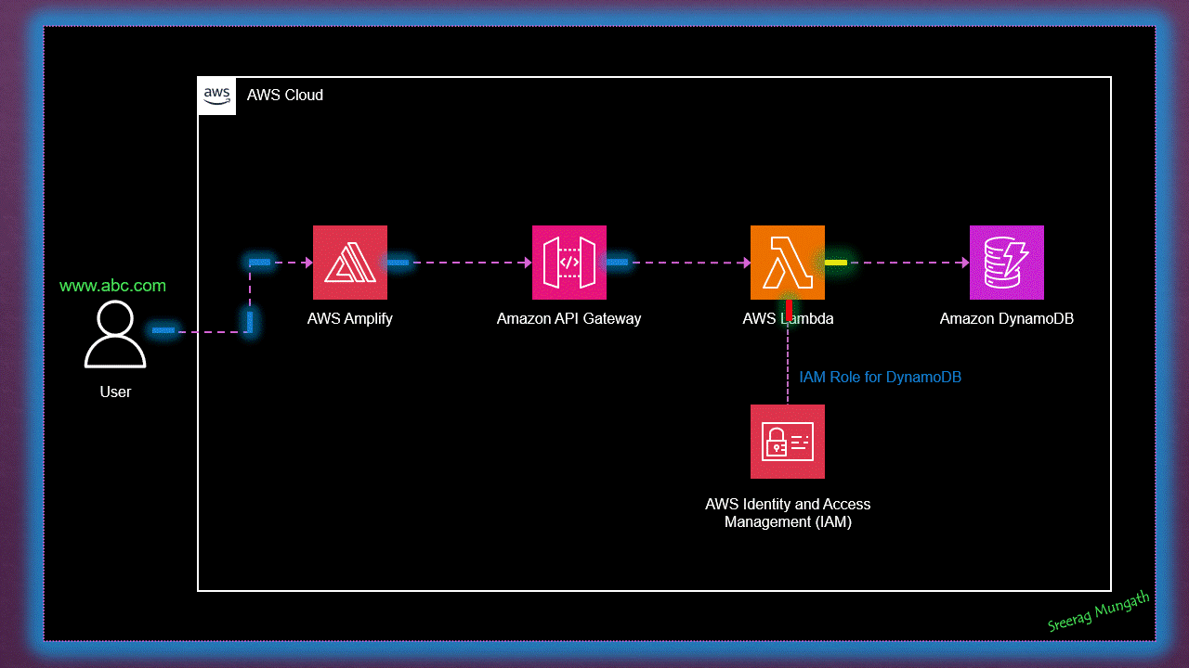
End-to-End Serverless Web Application

Slide 15
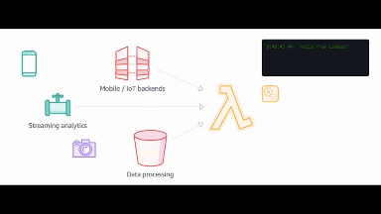
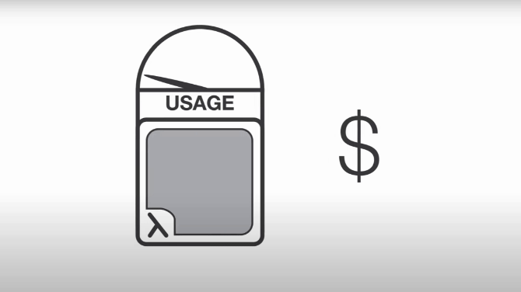
AWS Lambda
Description
Pricing
Compute service that runs your code in response to events and automatically manages the compute resources.
FREE TIER OFFER DETAILS:
Always Free for
1 million free requests per month
3.2 million seconds of compute time per month

Slide 16
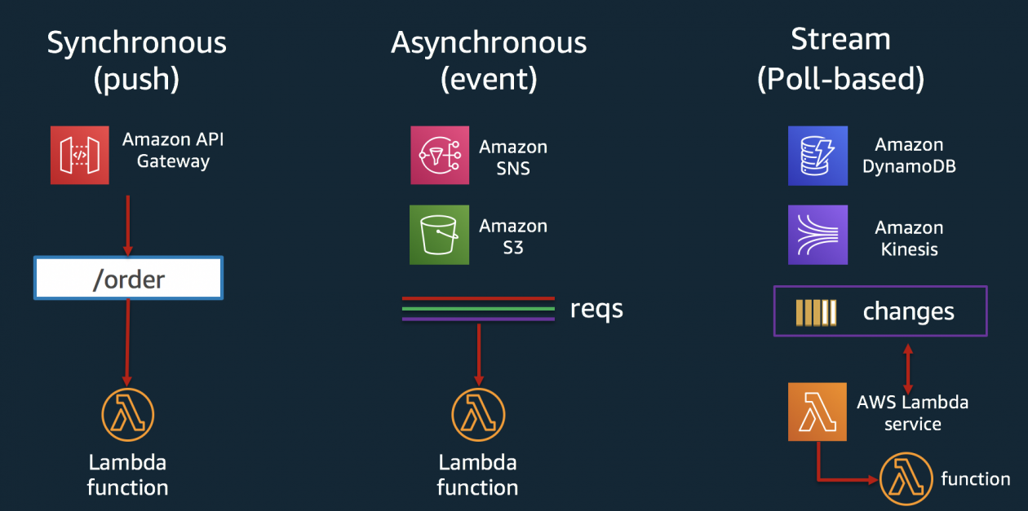
Different Ways to Invoke Lambda Function

Slide 17
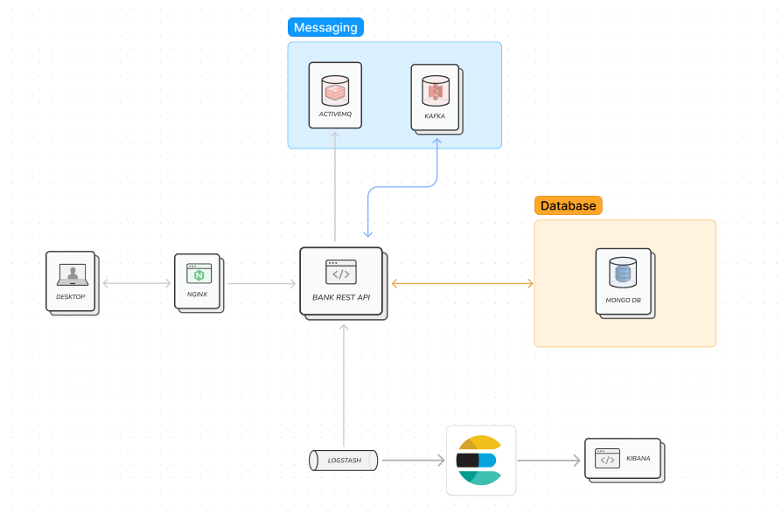
Bank Application On-Premise

Slide 18
AWS Lambda
500,000 requests per day
Yearly: 180,000,000 requests

Slide 19
How much would it cost on On-premise
Hardware Cost: (initial) $50,000 ($16,667/year)
Software Cost: (initial) $10,000 ($3,333/year)
Maintenance Cost: $7,500
Energy Cost: $5,256
Personnel Cost: $160,000
Cooling Cost: $2,628
Facility Cost: $10,000

Slide 20

Total Annual Cost
$205,384

Slide 21
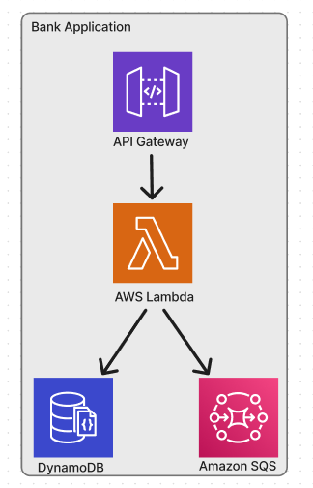
Light Deployment Architecture

Slide 22
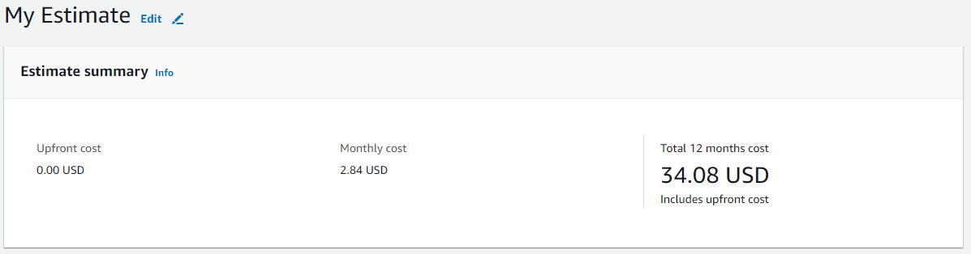
AWS LAMBDA

Slide 23

Profit
205,384 - 34.08 = 205,349.92

Slide 24
What we need to change to deploy Lambda
Implement handler class for AWS Lambda
Reduce loading time of Spring Boot
Avoid component scanning

Slide 25
Advantage of Lambda on Bank Application
No servers to Manage
Continuous Scaling
Pricing - Millisecond metering
Increases Innovation

Slide 26
Disadvantage of Lambda
Hard to adopt big scale enterprise Spring Boot
No Control Over Environment
More Complex Call Patterns

Slide 27
What we need to Consider about AWS LAMBDA with Spring Boot
Loading instances might be heavy
Need to implement warm function
Not good solution for Dependency heavy Applications

Slide 28
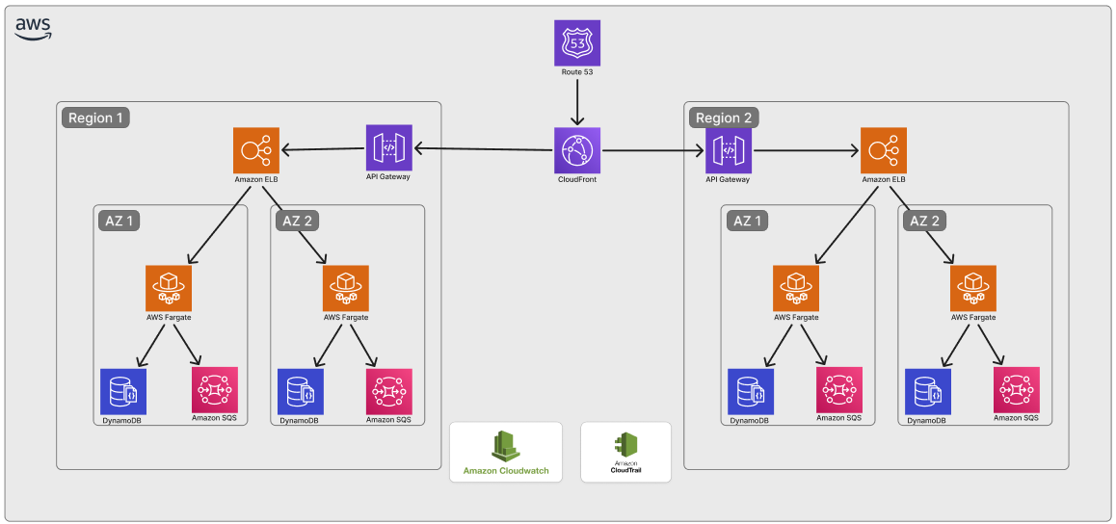
Full AWS architecture

Slide 29
Demo

Slide 30
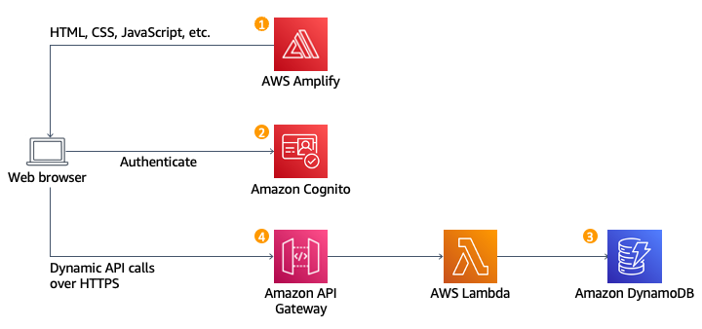
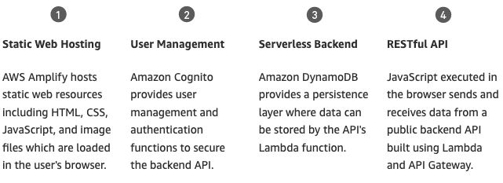
Demo – Serverless App

Slide 31
Important points of demo
Back-end Code
AWS Lambda Function
Front-end Code
AWS CodeCommit – A repository to store code (html, css, js, …)
Security
Authentication
AWS Cognito
Rest API
Amazon Api Gateway
DB
AWS DynamoDB
Deploy Front-end app
AWS Amplify
Monitor
AWS CloudWatch – Logging

Slide 32
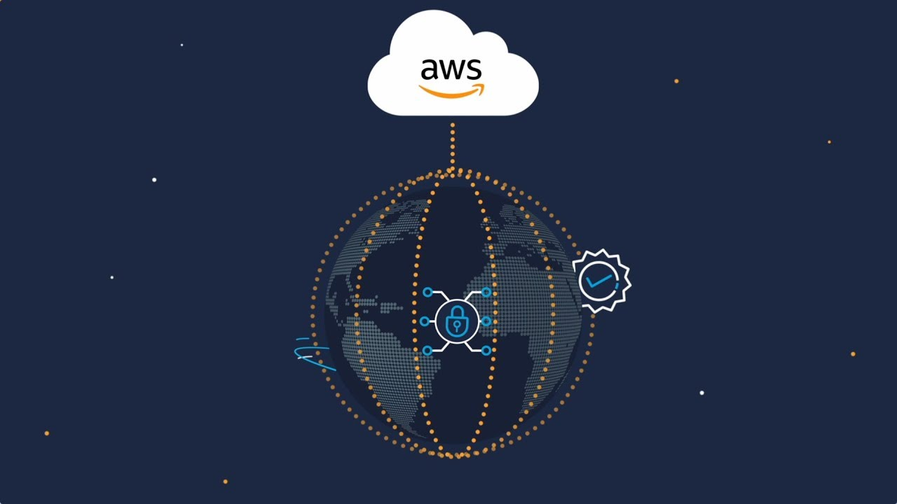
Thank you !

